Slide 1
THE RIGHT TO FREE MOVEMENT:
INDIGENOUS SOVEREIGNTY & THE US/CANADA BORDER
Presented by Natale Szabo
Notes:
This paper and presentation will be a bit different from most here, as I took the form of a policy proposal paper. I also want to mention that I did change the title of my paper and presentation from the original working title that is listed on the program, because I don’t consider it appropriate for me as a non-Indigenous person to identify what is or isn’t a “first step” towards reconciliation.

Slide 2
ACKNOWLEDGEMENT
I want to acknowledge before I begin that I’m currently calling in from Coast Salish territory that was taken through violence and coercion.
Settler colonialism is not a thing of the past, it’s ongoing.
The infringement of the rights of Indigenous people is not merely a subject for us to intellectualize in academic settings, it’s a moral and human rights crisis that requires direct action. To have to advocate for the rights of Indigenous people in terms of governmental legislation is in itself a form of colonial violence.
However, the erasure of a people is the first step in oppression, so with this presentation I seek to create visibility and hopefully spur ongoing awareness and action.

Slide 3
Background

Slide 4
HISTORY
1783:
Peace of Paris leads to US/Canada border
Border cuts through countless Native territories
1794:
Jay Treaty affirms the rights of Native Americans to cross the border
Notes:
-In 1783 the US/Canada border was established at the 49th parallel via the Peace of Paris agreement
- Since it was established without the consideration of the land’s original inhabitants, this new border bisected the territories of countless Indigenous groups across the continent including the Mohawk, Oceti Sakowin, Blackfoot, Kalispel, and Nooksack tribes.
-About 10 years later the Jay Treaty was negotiated between US and Great Britain in 1794, stating that Native people on either side of the border should be able to freely pass between the territories (didn’t create a new right)

Slide 5
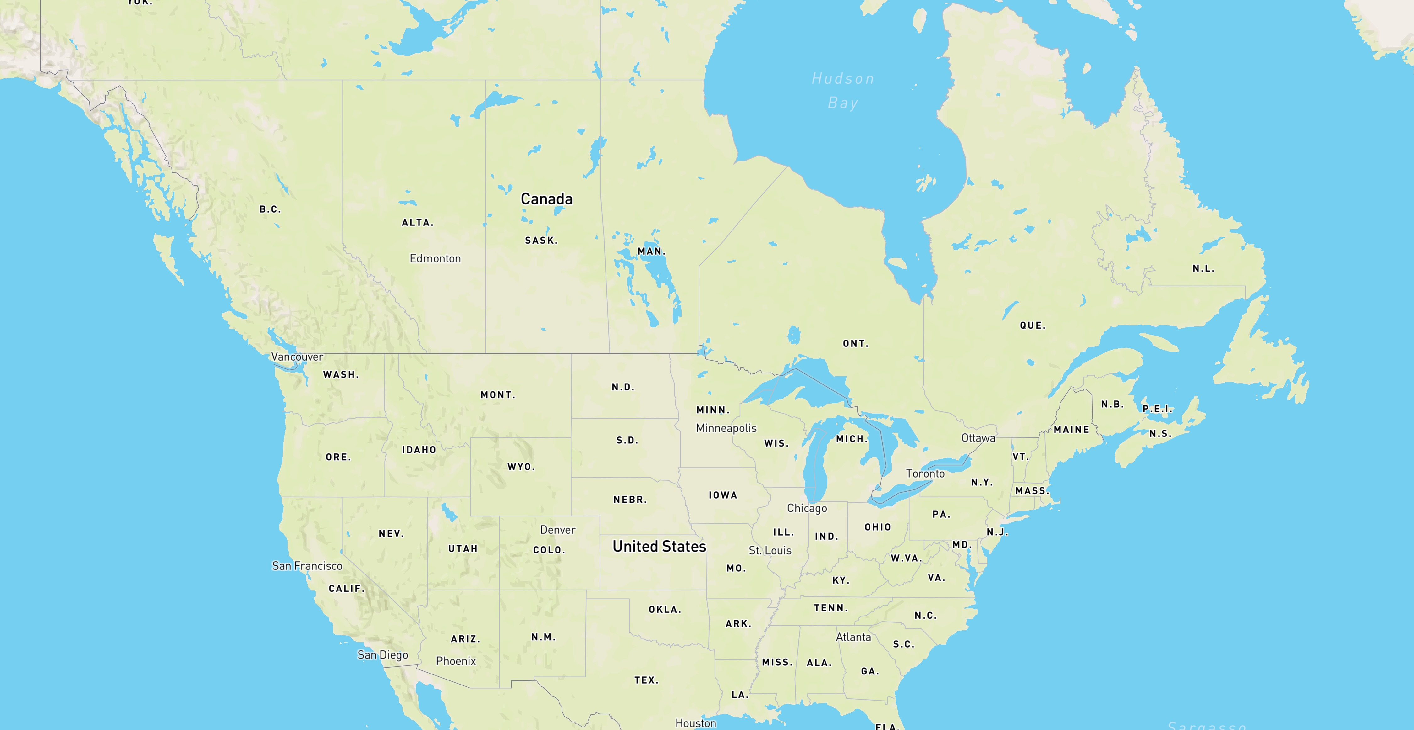
Notes:
To give you an idea of how this new border disrupted the traditional territories of tribes throughout the area, here is a present day map of the U.S. and Canada.

Slide 6
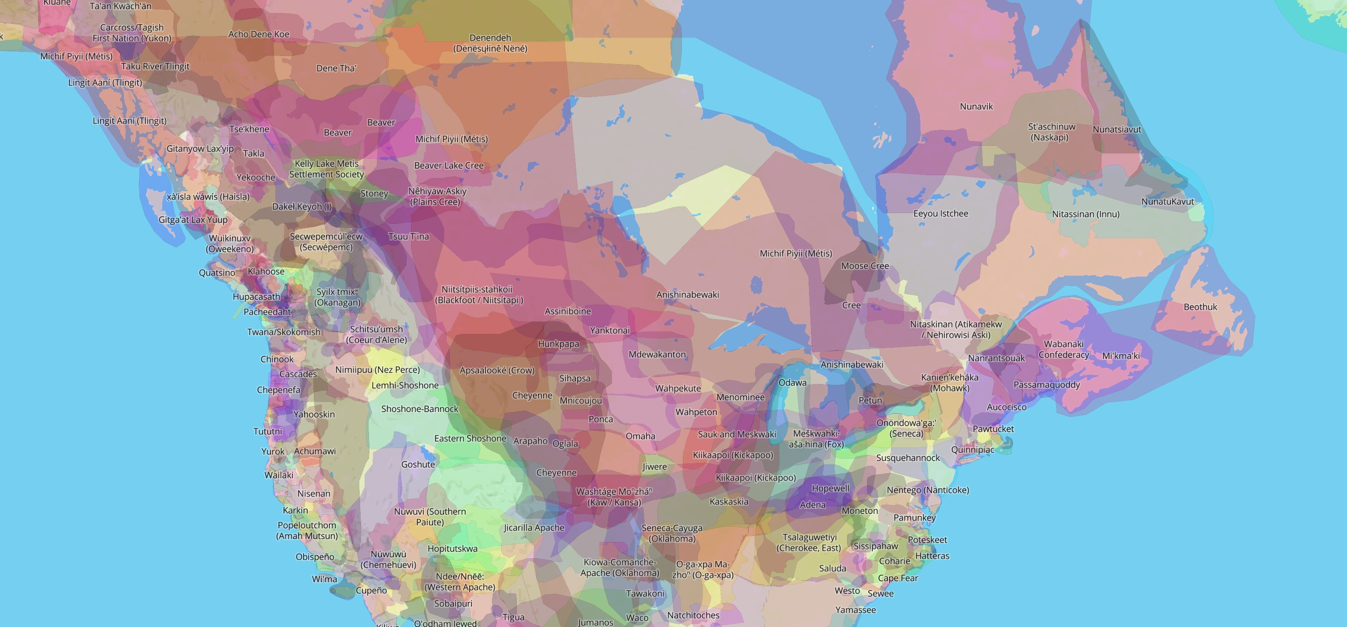
Source:
Native-Land.ca
Notes:
And this is a map of the vast array of intersecting and overlapping territories of the Indigenous tribes of the area, prior to European colonization.
This map is from Native-Land.ca, and I recommend everyone take the time to visit this website to find out what tribe’s land you currently exist on.

Slide 7
HISTORY
1952:
Immigration and Nationality Act (INA)
Introduced use of bloodline requirement
Still in use today
Notes:
-In 1952 the Immigration & Nationality Act went into effect, which set the laws that we use today regarding the legal ability of Indigenous people in Canada to cross into the US
-One of the notable aspects of this act was the use of a bloodline requirement to qualify to cross the border
-A lot happened between 1794 and 1952, but what’s important to know is that the US has gone back and forth between allowing free border crossing for Indigenous people and has classified eligibility in different ways, depending largely on the current feelings of the government toward IPs

Slide 8
MODERN CONTEXT
UN Declaration on the Rights of Indigenous Peoples
Adopted by UN in 2007
Both US and Canada initially voted against it
Adopted by Trudeau government in 2016
Passed into legislation in BC in 2019
Notes:
UNDRIP
Is a resolution adopted by the UN General Assembly in September of 2007
Both the US and Canada voted against it
Eventually adopted by Trudeau government of Canada in 2016
It is international law and thus applies to Canada and the US, though not legally binding
Nov 2019 - British Columbia passed legislation to implement the UN Declaration into law

Slide 9
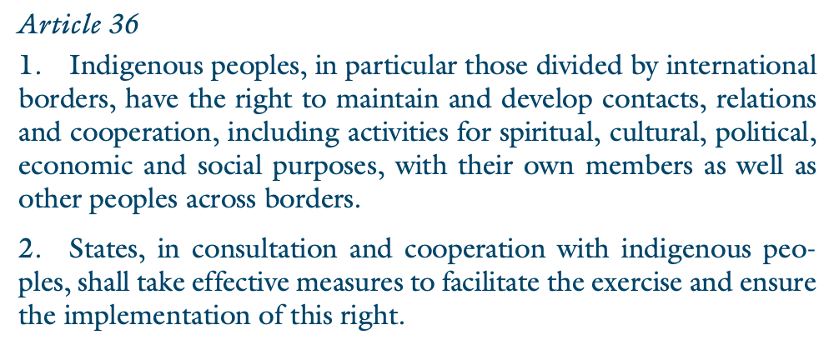
Notes:
An article in the declaration that's particularly important to this topic is Article 36, which states that indigenous people divided by international borders have the "right to maintain and develop contacts, relations and cooperation, including activities for spiritual, cultural, political, economic and social purposes, with their own members as well as other peoples across borders."

Slide 10
MODERN CONTEXT
R v. Desautel
In 2010 Richard Desautel, a US resident, shot an elk in Canada
He was charged for hunting without a license under the BC Wildlife Act
He was won at two levels of courts, and now BC is taking the case to the Supreme Court
Notes:
In Oct 2010, US Citizen Richard Desautel of the Sinixt (sin-EYExt) people, members of the Colville Confederated Tribes, crossed the border into Canada to shoot an elk in traditional Sinixt territory.
He was arrested by BC Conservation and charged with hunting without a license under the BC Wildlife Act
-He's been acquitted of his charges in both the provincial and appeals court
-BC gov now taking the case to the Canadian Supreme Court
-The main argument is that Indigenous Canadians who are citizens of the US exercising indigenous rights in Canada is ‘incompatible with Canadian sovereignty’
-It’s also important to point out again that the government of BC continues to push forward on this case despite implementing the UN Declaration on the Rights of Indigenous Peoples into law two years ago

Slide 11
Problems

Slide 12
MAIN ISSUE:
There is a massive incongruence between the US and Canada in their laws regarding the free movement of Indigenous people across the border.
Canada
United States
Doesn't honor the Jay Treaty
Section 35 of the Constitution
Entry based on performing cultural activity
Immigration & Nationality Act
50% Native bloodline required
Tribal membership irrelevant
Notes:
The main issue: There is a massive incongruence between the US and Canada in their laws regarding the free movement of Indigenous people across the border.
Much of this comes from a seemingly small, but very consequential difference in the governments of the two countries.
US considers treaties as having the same status as law, “supreme law of the land” (Supremacy Clause of US Constitution).
Canada on the other hand, does not treat treaties as law unless backed by legislation.
So currently Canada does not honor the Jay treaty because the Jay Treaty was never enabled by legislation.
US-Canada border established w/ treaty & also never enabled with leg…. Which you’ll come to see with some research that hypocrises abound in the arena of governments recognizing Indigenous rights.
Section 35 of Canadian Constitution affirms ‘existing aboriginal and treaty rights of aboriginal peoples of Canada’
Entry to Canada based on performing an activity that is “integral to a distinctive culture”
Doesn’t contain bloodline requirement
Barrs thousands of US-born First Nations people from living, working, or sometimes even visiting lands in Canada that they are indigenous to
The current law in the United States is based on the Immigration and Nationality Act. Under this act
Any Canadian with a 50% native bloodline is considered Legal Permanent Resident
Must apply for green card to officially document this status
Under the bloodline requirement, tribal membership is irrelevant.

Slide 13
OTHER ISSUES:
Ongoing legal battles
Blood quantum requirement
Import/export and wildlife laws
Documentation inconsistencies
Notes:
This is not the only case involving rights of Indigenous people to cross the border- there are many, including ongoing cases involving the Mohawk people near the St. Lawrence River on the East Coast and Mique’l Dangel’i in Alaska, who is fighting for her right to teach her disappearing traditional language at a school in Canada.
Another issue is the use of the blood quantum requirement to enter the US.
A bloodline requirement was not present in original Jay Treaty, went into effect in 1952 INA
The major issue with this is that it makes Tribal enrollment irrelevant, and many nations don’t require 50% bloodline
Burden on applicant to prove bloodline from familial birth certificates, tribal records, etc. which are often difficult or even impossible for individuals to obtain
Those without green card must prove 50% bloodline each time they cross border, which ends up leaving their entry to the discretion of the particular border agent that inspects their documents.
Ultimately the bloodline requirement serves to narrow class of eligible Indigenous people
Import/export and wildlife protection laws also often create additional issues. Laws regulating the transport of goods, plants, and animals can interfere with the ability of Native people to transport items for ceremonial or traditional purposes across the border. The Marine Mammal Protection Act, Bald and Golden Eagle Protection Act are two examples of this.
This effectively removes the ability of Indigenous groups to practice traditions, which is in violation of Article 11 of the UNDRIP.
Documentation inconsistencies
Even though any Canadian who is Aboriginal/Native American is guaranteed the right to work in the US, those without green card documentation can’t receive work authorization with the current automated system that checks eligibility.
Additionally, Passports are required to cross US/Canada border, and only a few tribes have documents that serve in place of a passport.

Slide 14
POLICY OPTIONS
Ignoring this issue will continue to contradict any wishes for "reconciliation," and exacerbate current tensions.
It's time for a new stance on Indigenous freedom of movement.

Slide 15
Bilateral recognition
CRITERIA
FOR POLICY RECOMMENDATIONS:
Center Indigenous Sovereignty
Adheres to UNDRIP

Slide 16
Policy Recommendation

Slide 17
PROPOSAL:
Adopt a bilateral policy of free movement across the border. This policy should include implementation of the Jay Treaty in Canada and both countries should offer the option of tribal membership or blood quantum for eligibility.
Notes:
So as a crucial step towards Indigenous sovereignty and reconciliation, I propose the the U.S. and Canada adopt a bilateral policy of free movement across the border. This policy should include implementation of the Jay Treaty in Canada and both countries should offer the option of tribal membership or blood quantum for eligibility.
Currently, the U.S. utilizes a test of a 50% quantum of Native blood to enter. The Jay Treaty traditionally used tribal membership. Allowing the option to use one method or the other would expand the pool of eligible people without removing eligibility for anyone who currently has it. Provisions should be set to leave room to expand eligibility further in the future to ensure full compliance with Article 36 of the U.N.D.R.I.P.

Slide 18
THIS POLICY MUST INCLUDE:
Exclusions from border regulations inhibiting the practice of customs
Uniform documentation ensuring right to work and access services
Release of all decisions of eligibility to Indigenous peoples
Notes:
In order to meet the criteria of centering Indigenous sovereignty and adhering to U.N.D.R.I.P., it is essential that Aboriginal Canadians and Native Americans are excluded from any border regulations that would inhibit the transport of sacred materials necessary to traditional tribal practices. Not only are these laws having unintended consequences by policing those who arguably contribute the least to environmental degradation, but the experience of a border inspection of sacred items can be traumatic for those who carry them. Tribal groups should be consulted and deferred to when identifying which specific laws cause this harm.
Uniform documentation will allow for easier border crossing and will allow all Indigenous people the right to work and access services in their neighboring country, regardless of green card status. It is important that this documentation not be attached to a passport as the only option, as the requirement for a passport in itself signifies a symbolic affront to Indigenous sovereignty. A report in Canada that consulted First Nations groups suggest some options such as the widespread adoption of an Enhanced Tribal Card (ETC) or an improved Certificate of Indian Status (CIS) that does not include an expiration date.
Once again, it is crucial that affected tribal groups on both sides of the border are empowered to guide any decisions regarding these issues. So this policy ultimately must release all decisions of eligibility to Indigenous groups themselves.

Slide 19
In order for the U.S. and Canada to achieve reconciliation with Indigenous peoples in the defined sense of restoring friendly relations, both governments must first reconcile the existing incompatibility between statements supporting Indigenous rights and government actions that continue to infringe on sovereignty.

Slide 20
A broader bilateral approach should be taken on Indigenous rights, as the economic entanglement of the two countries and the struggles of the Indigenous people within them are inextricably linked.

Slide 21
Thank you
Feel free to reach out with questions.

